Slide 1


Investor Presentation
May 2024

Slide 2
Legal Disclaimer
Forward-Looking Statements
This presentation includes forward-looking statements. These forward-looking statements can be identified by the use of forward-looking terminology, including the terms as “believe”, “expect”, “anticipate”, “may”, “assume”, “plan”, “intend”, “will”, “should”, “estimate”, “risk” and or, in each case, their negative, or other variations or comparable terminology. These forward-looking statements include all matters that are not historical facts and include statements regarding the Company’s intentions, beliefs or current expectations concerning, among other things, Vallourec’s results of operations, financial condition, liquidity, prospects, growth, strategies and the industries in which they operate. Readers are cautioned that forward-looking statements are not guarantees of future performance and that Vallourec’s or any of its affiliates’ actual results of operations, financial condition and liquidity, and the development of the industries in which they operate may differ materially from those made in or suggested by the forward-looking statements contained in this presentation. In addition, even if Vallourec’s or any of its affiliates’ results of operations, financial condition and liquidity, and the development of the industries in which they operate are consistent with the forward-looking statements contained in this presentation, those results or developments may not be indicative of results or developments in subsequent periods. By their nature, forward-looking statements involve risks and uncertainties because they relate to events and depend on circumstances that may or may not occur in the future. These risks include those developed or identified in the public documents filed by Vallourec with the French Financial Markets Authority (Autorité des marchés financiers, or “AMF”), including those listed in the “Risk Factors” section of the Registration Document filed with the AMF on March 14, 2024, under filing number n° D. 24-0113.
Accordingly, readers of this document are cautioned against relying on these forward-looking statements. These forward-looking statements are made as of the date of this document. Vallourec disclaims any intention or obligation to complete, update or revise these forward-looking statements, whether as a result of new information, future events or otherwise, except as required by applicable laws and regulations. This presentation does not constitute any offer to purchase or exchange, nor any solicitation of an offer to sell or exchange securities of Vallourec. For further information, please refer to the website www.vallourec.com.
Information
Quarterly statements are unaudited and not subject to any review. Audit procedures have been carried out for the full year consolidated financial statements.
Unless otherwise specified, indicated variations are expressed in comparison with the same period of the previous year.

Slide 3
1
Investment Overview

Slide 4




The Vallourec Investment Case
Vallourec is a mission-critical supplier of complex steel tubular solutions supported by industry-leading R&D and world-class production facilities.
Financial Figures
Zero Net Debt
by year-end 2025 at the latest
We are making Vallourec more profitable, more resilient and more cash-generative while delivering on our ambitious ESG targets.
€850m
Midcycle EBITDA
We see multi-year tailwinds across Oil & Gas and New Energies markets that will drive robust demand for our products and services.
€450m
Midcycle total cash generation
We aspire to be one of the most shareholder-friendly companies within our peer group, with cash distribution starting in 2025 at the latest.
Aspiration to return
80% – 100%
of total cash generation to shareholders
Notes: Vallourec’s dividend policy would in any event be conditional upon the Board’s decision taking into account Vallourec’s results, its financial position including the deleveraging target and the potential restrictions applicable to the payment of dividends. Dividends and share repurchases would also be subject to shareholders approval. The midcycle simulation shown in this presentation does NOT represent guidance, forecast, target or outlook of Vallourec for any particular financial year, but aims to represent an abstract average across cycles and across different circumstances to illustrate, in a volatile and unpredictable environment, the theoretical functioning of the New Vallourec.

Slide 5
The New Vallourec Plan
Key Objectives
Tools Utilized
Primary
Strategic Goals
Financial
Targets
Operational
Initiatives
Governance Improvements
€230m EBITDA / €250m FCF Improvement¹
Realigning Our
Industrial Footprint
Reshaping Our Management Team
Deliver
Best-in-Class
Profitability
Close Profitability Gap with Primary Peer
Emphasizing
Value over Volume
Positive FCF
through the Cycle²
Setting
Ambitious
ESG Targets
Make
Vallourec
Cycle-Proof
Improving Our
Pricing Strategy
Achieve Zero Net Debt by Year-End 2025 at the Latest
¹ Measured versus 2021 baseline, consistent with New Vallourec plan announced in May 2022. Full effect expected in Q2 2024. FCF is aligned with prior definition of free cash flow.
² Aligned with prior definition of free cash flow. See “Definitions of Non-GAAP Financial Data.” Target excludes the impact of working capital.

Slide 6
Significantly Reshaped Production Footprint
Changes resulting from the New Vallourec plan
Closed ~700kt of rolling capacity and various finishing sites
Premium finishing capacity increased by 40kt
North America
Domestic Capacity for
Domestic Demand
Europe
Finishing and
Niche Products
Reduced rolling capacity by ~300kt; repositioned towards premium export products
Saudi Arabia
Local Value-Add
East Asia
Premium
Export Hub
Invested in enhanced production capabilities to enable transfer of >100kt of Oil & Gas production
Fully Integrated
Rolling & Finishing
South America
Domestic Leader and
Premium Export Hub
Finishing Only
Product Flows
Note: Product flow arrows represent finished product sales, but do not account for intermediate flows to local finishing capacity. Aulnoye Forge not included as “rolling & finishing” in diagram.

Slide 7
2022 New Vallourec Plan Fully Executed; More to Come
Already Implemented
More to Come
Go-to-Market
Strategy
Enhanced global pricing policies
Exit of European Industry market
Exit of China domestic market¹
Develop premier New Energies franchise
Grow services and accessories revenues
Operational Initiatives
Planned closure of European assets
Investment in Brazilian capabilities
Global overhead cost reduction
Drive further industrial excellence in Brazil
Harness the power of data in our operations
Financial Management
Working capital optimization
Significant deleveraging
Enhanced liquidity facilities (ABL)
Continuous cost and cash discipline
Capital returns to shareholders
1 Excluding volumes served from the Changzhou Forge (niche products)

Slide 8
A Significant Balance Sheet Transformation
Debt
Liquidity
Net Debt (€ Million)
€ Million
Gross Debt (€ Million)
Please see “Definitions of Non-GAAP Financial Data” in the Appendix

Slide 9
Holistic Debt Refinancing Executed in April 2024
Gross debt to be reduced by €550m+
Strong liquidity for all market conditions
€ Million
€ Million
Q1 2024
Gross Debt
2026 Senior Notes
PGE Repaid in April
PGE to be Repaid by Year-End
2032 Senior Notes¹
Other Effects²
Pro Forma
Gross Debt
Q1 2024
Liquidity
Cash
Used in Refinancing³
PGE to be Repaid by Year-End
Increased RCF
Increased ABL
Pro Forma
Liquidity
¹ Includes effect of estimated transaction costs related to note issuance which will be amortized over the life of the debt, assuming a Euro/US dollar FX rate of ~1,07.
² “Other effects” include the reversal of fair value accounting, accrued interest on 2026 notes and PGE as of March 31st 2024, and estimated other transaction costs.
³ Includes accrued interest on 2026 notes and PGE as of March 31st 2024, and estimated transaction costs.

Slide 10
2
Operations & Financials

Slide 11




Supplier of Mission-Critical Premium Seamless Tubular Solutions
Focused on high-end seamless tubular solution
Highly demanding applications for our products
Vallourec Focus
Vertical Well
Section
Up to 10,000 meters
Commercial Airline
Cruising Altitude
~10,000 meters
Welded Tubes
Seamless Tubes
Mount Everest
8,849 meters
Product Summary
Lower-end products made by rolling flat steel into a tube and welding the seam
Higher-end products made by piercing and extending a round steel billet
Vallourec
Tubes
Product Price and Complexity
Lower-cost product with simpler manufacturing process but insufficient performance in demanding applications
Higher-cost product with complex manufacturing process, ability to perform in demanding applications
Horizontal Well
Section
Up to 10,000 meters

Slide 12
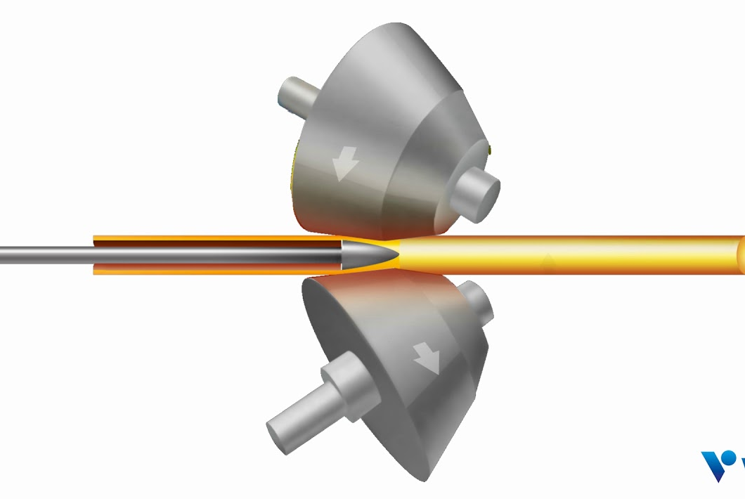



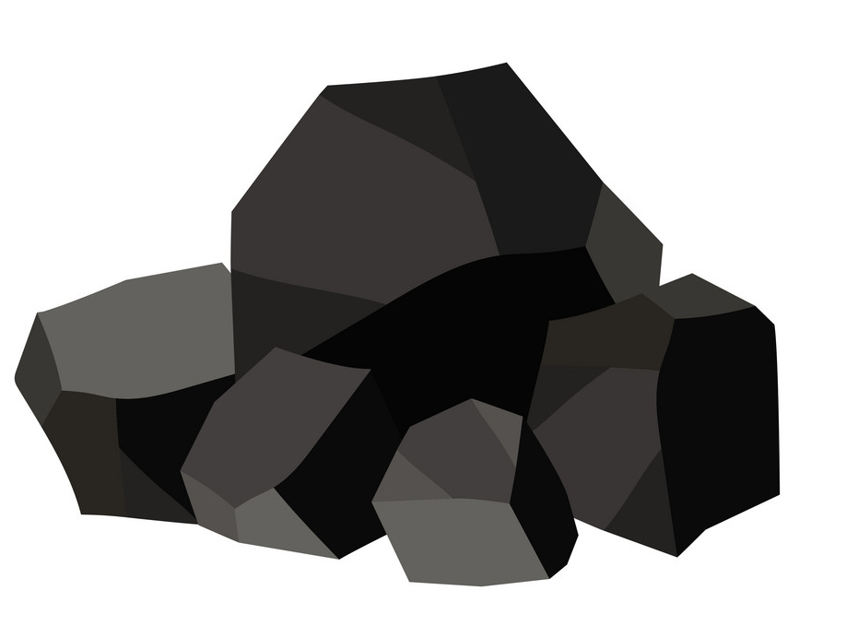

The Seamless Tube Production Process
Heat Treatment
Raw Material Sourcing
Steelmaking
Rolling
Threading
  Externally sourced scrap
  and recycled process scrap
  OCTG Only
Scrap Metal
Iron Ore
Pelletizing Plant
Pellets
Cast Iron
Lumber
Kiln
Charcoal
Blast Furnace
  Conversion of scrap steel, iron and alloys into round billets
  Piercing and elongation of billets into hollow tubes
  Heating and cooling process to alter tubes’ mechanical properties
  Machining connection threads onto ends of tubes
  Internally-sourced iron ore & green charcoal
  Increasing Value-Add

Slide 13
Midcycle Tubes Earnings Power Simulation
Metric | Assumption | Comments
Operating Assumptions
Total sales volumes (k tonnes) | 1,700 | Maximizing premium mix as opposed to maximizing volumes
Vallourec average selling price ($) | $2,800- $3,000 | Assumes market prices in the low-mid $2k per tonne range + Tier 1 premium
USD / EUR | ~1.10
Vallourec average selling price (€) | €2,650 | At midpoint of assumed pricing range
Total costs per tonne (€) | €2,200 | Assumed to remain elevated versus history
EBITDA per tonne (€) | €450
Simplified Tubes P&L
Revenues | €4.5b
EBITDA | €750m
EBITDA % Margin | 17%
Notes: All per-tonne metrics rounded to nearest multiple of 50. Revenue is rounded to nearest €100 million, EBITDA to nearest €50 million increment. Total cost per tonne includes Cost of Sales and SG&A. The midcycle simulation shown in this presentation and related assumptions do NOT represent guidance, forecast, target or outlook of Vallourec for any particular financial year, but aim to represent an abstract average across cycles and across different circumstances to illustrate, in a volatile and unpredictable environment, the theoretical functioning of the New Vallourec. Average selling price defined as revenue divided by sales volumes.

Slide 14




The Mining Process
Beneficiation Plant
Dispatch & Sales
Run of Mine
(ROM)
Iron Ore
Open Pit
Wet
Tailings
Dewatering Filter
Waste Pile
Dry
Tailings
Waste
Waste and
Dry Tailings
External Waste

Slide 15
Mine Earnings Power and Growth Potential
Near-term operational targets
Two-phase extension plan in progress
6.0m
New near-term¹ annual iron ore production target (m tonnes)
 | Phase 1 | Phase 2
Incremental Annual Iron Ore Production⁴ | – | +1mt – 2mt
Incremental Annual EBITDA⁴ | +€20 – €25m | +€50m – €75m
Estimated Project Capex (€m)⁵ | €20m | €100m – €125m
Expected Start-Up | Late 2024 | 2027
1.0m
Production used to support Tubes production business (m tonnes)
40% – 45%
Weighted average contractual selling prices as a percentage of Platt’s iron ore index²
€20 – €25
Total cost of extraction, overhead, and SG&A per tonne
~€100m
Annualized EBITDA run-rate³
¹ 6 million tonne annual production target commences in 2024
² “Platt’s iron ore index” refers to 62% Fe CFR China index
³ Assuming Platts index around $110 per tonne
⁴ Measured relative to near-term baseline metrics on left of page
⁵ Capital expenditures for Phase 2 are still pending further project planning and evaluation. Actual project spending may vary versus current assumptions based on further cost evaluation

Slide 16
Midcycle Cash Flow Simulation: Significant Potential Returns
Metric | Assumption | Comments
EBITDA (€)
Tubes | €750m
Mine & Forest | €125m
Holding & Other, Intersegment | (€25m)
Group EBITDA | €850m
Cash Flows (€)
Capital expenditures | €175m | Including mine extensions, can reduce to ~€125m in downturn
Financial cash out | €50m | Assuming zero net debt, with costs for minimal gross debt and other items
Cash tax | €175m | High 20% range depending on blend of regional profits
Group total cash generation | €450m
Aspired total cash generation payout ratio¹ | 80% – 100% | In line with highest ratios in the market
¹ Vallourec’s dividend policy would in any event be conditional upon the Board’s decision taking into account Vallourec’s results, its financial position including the deleveraging target and the potential restrictions applicable to the payment of dividends. Dividends and share repurchases would also be subject to shareholders approval. The midcycle simulation and related assumptions shown in this presentation do NOT represent guidance, forecast, target or outlook of Vallourec for any particular financial year, but aim to represent an abstract average across cycles and across different circumstances to illustrate, in a volatile and unpredictable environment, the theoretical functioning of the New Vallourec.
Analysis excludes changes in working capital, asset disposals and restructuring cash out. The midcycle simulation shown in this presentation does NOT represent guidance, forecast, target or outlook of Vallourec for any particular financial year, but aims to represent an abstract average across cycles and across different circumstances to illustrate, in a volatile and unpredictable environment, the theoretical functioning of the New Vallourec.

Slide 17
2024 Earnings, Cash Flow and Net Debt Outlook
Second Quarter 2024
Full Year 2024
Tubes
Volumes to increase sequentially due to higher international shipments; EBITDA per tonne to decline primarily due to lower US pricing
Strong international market environment to persist with results benefiting from strong
pricing already in backlog
Mine & Forest
Production sold to be slightly higher vs. Q1
Production sold to be approximately 6m tonnes
Group EBITDA
EBITDA to moderately decline versus Q1
due to US market dynamics
Group EBITDA margin to remain strong due to robust international Tubes pricing and continued operational improvement
Total Cash Generation & Net Debt
Expect to reduce net debt further
vs. the Q1 2024 level¹
Total cash generation to be positive and
net debt to meaningfully decline
versus the Q1 2024 level¹
¹ In all cases, total cash generation and net debt guidance excludes the potential positive impact of major asset sales.

Slide 18
3
Market Dynamics

Slide 19

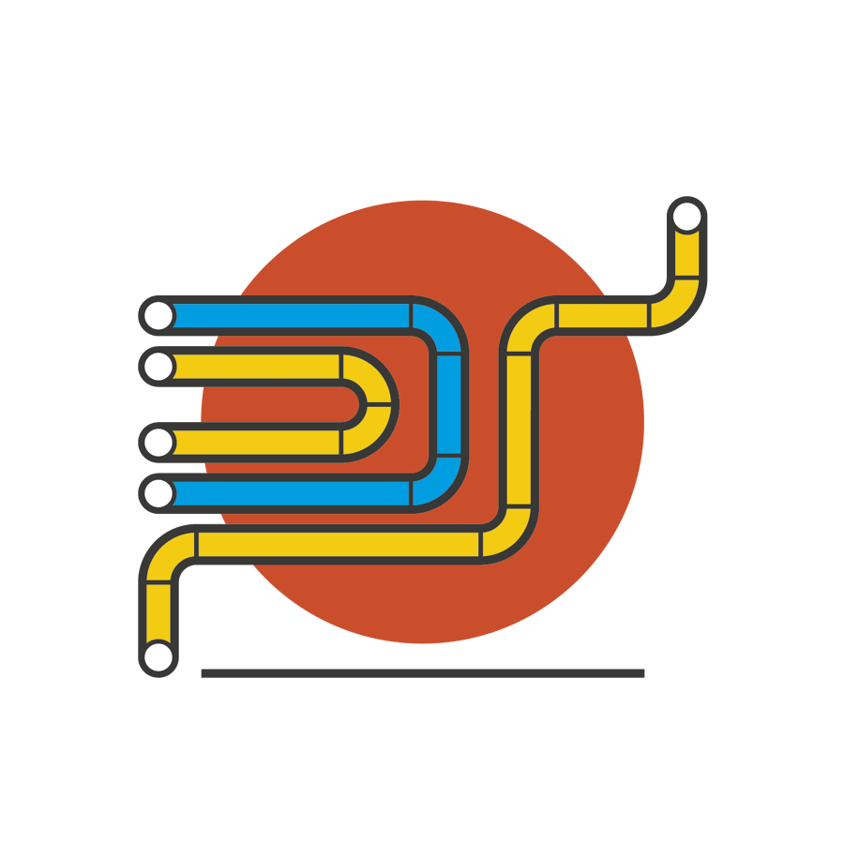


Key Seamless Tubes Markets
 | Oil Country Tubular Goods (OCTG) | Project Line Pipe (PLP) & Process | Industry & Other | New Energies
2023E ASP (price/tonne) | Mid $3k | Low-mid $2k | Low $2k¹ | High-Growth Emerging Market
2023E Total Market Size (mt) | 9.6 | 4.4 | Not Analyzed
2023E Served Market Size (mt) | 5.4 | 1.1 | 0.4 | 21.7
% of Vallourec Tubes Volumes² | 65% – 70% | 15% – 20% | 10% – 15% | 9.5
Market Growth Outlook | Cyclical Upturn | Cyclical Upturn | Cyclical Slowdown | High Structural Growth
Primary End-Markets | Upstream Oil & Gas | Oil & Gas and Petrochemicals | Automotive, Agribusiness, Construction, etc. | Carbon Capture, Geothermal, Hydrogen
Primary Customers | Oil & Gas Operators | Engineering & Construction Firms | Diversified | Diversified
¹ Refers only to continuing Industrial business in Brazil; excludes production from Germany
² Pro forma for New Vallourec plan
Sources: Internal market intelligence based on public peer commentary, Rystad Energy, Preston Pipe, OCTG Situation Report, PipeLogix

Slide 20

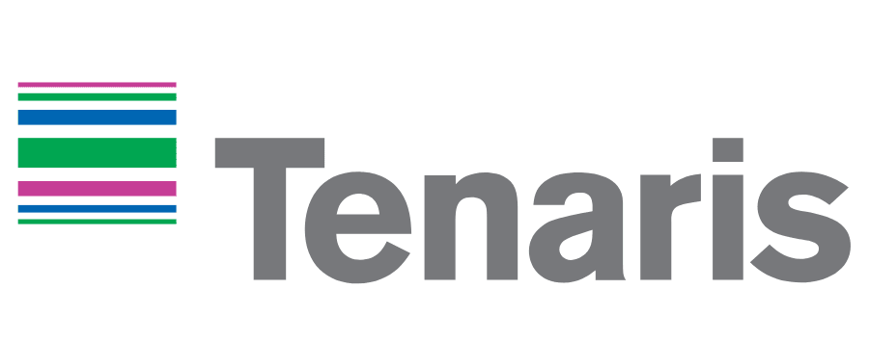









Limited Set of Premium Seamless Tube Suppliers
Tier 1 Global Suppliers
~6 million tonnes annual production
Suppliers Unable to Access Global Premium Market
Regional Western Suppliers
~2.5 million tonnes annual production
Asia and CIS Suppliers
>10 million tonnes annual production
Note: reflects production estimates for 2023

Slide 21
Major Seamless OCTG Markets
2023 Market Size (Million Tonnes)
CIS
North America
1.3
2.9
2.9
Europe
0.2
1.0
China
Africa
0.3
Middle East
0.5
Asia Pacific
Ex-China
0.5
South America
Dominant Connection Technology
Proprietary
API
Sources: Internal market intelligence based on public peer commentary, Rystad Energy, Preston Pipe, OCTG Situation Report, PipeLogix

Slide 22
US OCTG Market: Pricing Not Yet Reflecting Market Balance
Rig count stable since October
Inventories have normalized
Pricing still somewhat lower
US Horizontal Rig Count
Months of OCTG Inventory
Seamless OCTG Price ($ / Tonne)
*
Sources: Baker Hughes, PipeLogix, OCTG Situation Report. Reflects average pricing for all seamless products. *Values greater than 8 months are not shown.

Slide 23
International OCTG Market: Demand Remains Robust
International offshore activity at post-COVID high
International market pricing remains strong
Onshore Rig Count Offshore Rig Count
Seamless OCTG Price ($ / Tonne)
Sources: Baker Hughes, Rystad Energy. OCTG pricing reflects price of L80 tubes (Premium) in Jebel Ali (Middle East) and North Sea.

Slide 24
Strong Market Prices Reflecting Tight Supply-Demand, Costs
Tubes market in the midst of a strong upturn
Industry costs point to higher landing for prices
Historical OCTG Market Pricing ($ / tonne)
Tier 1 OCTG Supplier Average Cash Cost of Sales ($ / tonne)
Industry costs up >$600/tonne vs. prior cycle
Sources: Vallourec estimates, OCTG Situation Report, PipeLogix, Rystad Energy
Note: Benchmarks refer to US Semi-Premium Seamless prices and International Premium Seamless pricing. Tier 1 Players are included where data is available. Average selling price defined as revenue divided by sales volumes.

Slide 25
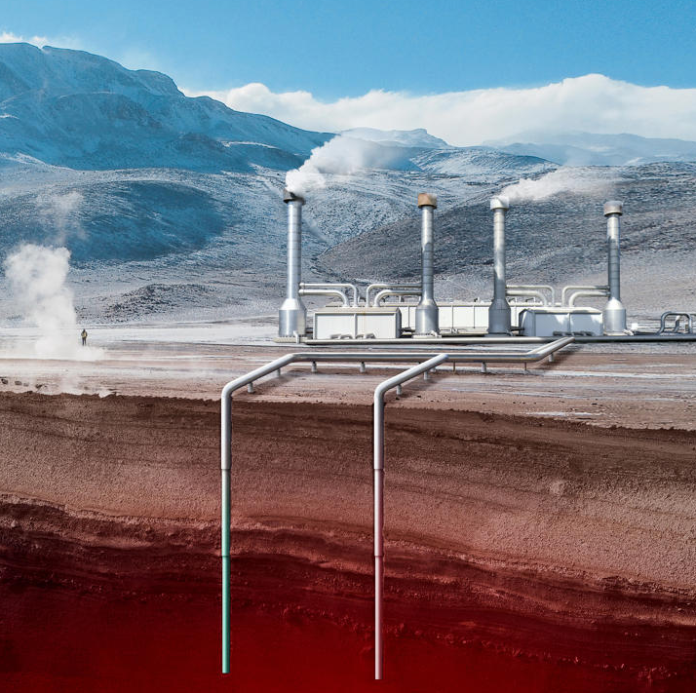
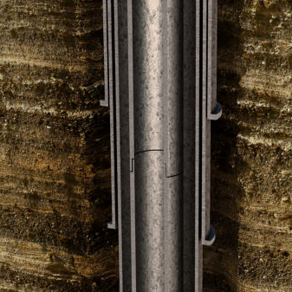
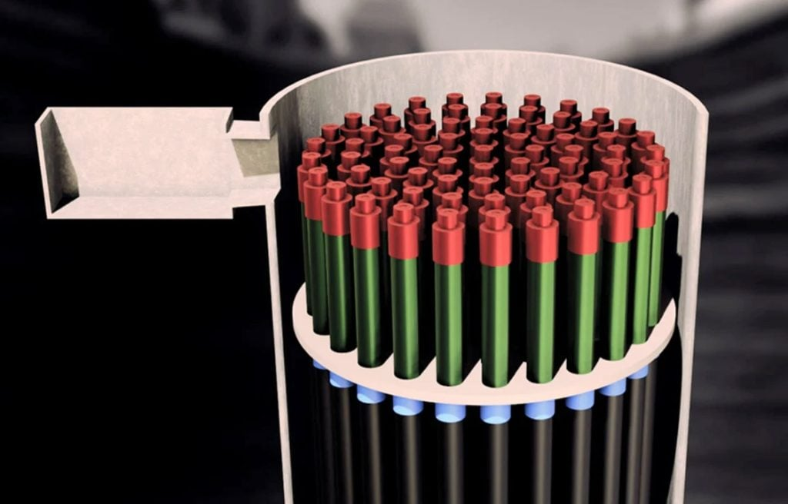
Significant Growth Potential in Our New Energies Business
Geothermal
Carbon Capture, Utilization and Storage (“CCUS”)
Hydrogen
Primary Tubes Application
Casing for
geothermal wells
Casing and tubing for CO₂ injection wells; transportation line pipes
H₂ storage systems; transportation
line pipes
Key Product Needs
Heat resistance; connection integrity during thermal expansion
Corrosion resistance; excellent toughness at low temperatures, long-term well integrity
Extremely tight connections; advanced metallurgy to resist hydrogen embrittlement
Vallourec Positioning
Tubes and connections validated and in use in geothermal wells
Tubes and connections validated and in use in CO₂ injection wells
Tubes and connections validated and in use in H₂ storage wells; storage POC complete
Product Illustration
CO₂
Target: New Energies to comprise 10-15% of Group EBITDA by 2030

Slide 26
3
Financial
Data

Slide 27
Summary Income Statement
*Share count not shown due to significant changes in share capital resulting from the restructuring

Slide 28
Summary Balance Sheet

Slide 29
Cash Flow Summary
Note: due to a change in cash flow reporting format, all figures prior to 2022 should be considered unaudited estimates provided for informational purposes.

Slide 30
Segment Data
Segment Key Performance Indicators
Tubes Revenues by Geography
* Volume sold in thousand tonnes for Tubes and million tonnes for Mine & Forest
“H&O” = Holding & Other; “Int.” = Intersegment

Slide 31
Definitions of Non-GAAP Financial Data and Concepts
Adjusted free cash flow is defined as adjusted operating cash flow +/- change in operating working capital and gross capital expenditures. It corresponds to net cash used in operating activities less restructuring and non-recurring items +/- gross capital expenditure.
Adjusted operating cash flow is defined as EBITDA adjusted for non-cash benefits and expenses, financial cash out and tax payments.
Asset disposals and other cash items includes cash inflows from asset sales as well as other investing and financing cash flows (e.g. loan reimbursements).
Change in working capital refers to the change in the operating working capital requirement.
Data at constant exchange rates: The data presented “at constant exchange rates” is calculated by eliminating the translation effect into euros for the revenue of the Group’s entities whose functional currency is not the euro. The translation effect is eliminated by applying Year N-1 exchange rates to Year N revenue of the contemplated entities.
EBITDA: Earnings Before Interest, Taxes, Depreciation and Amortization is calculated by taking operating income (loss) before depreciation and amortization, and excluding certain operating revenues and expenses that are unusual in nature or occur rarely, such as:
  impairment of goodwill and non-current assets as determined within the scope of impairment tests carried out in accordance with IAS 36;
  significant restructuring expenses, particularly resulting from headcount reorganization measures, in respect of major events or decisions;
  capital gains or losses on disposals;
  income and expenses resulting from major litigation, significant roll-outs or capital transactions (e.g., costs of integrating a new activity).
Financial cash out includes interest payments on financial and lease debt, interest income and other financial costs.

Slide 32
Definitions of Non-GAAP Financial Data and Concepts
Free cash flow, as previously defined, may continue to be derived as follows: total cash generation - asset disposals & other cash items. This is also defined as EBITDA adjusted for changes in provisions, less interest and tax payments, changes in working capital, less gross capital expenditures, and less restructuring/other cash outflows.
Gross capital expenditure: gross capital expenditure is defined as the sum of cash outflows for acquisitions of property, plant and equipment and intangible assets and cash outflows for acquisitions of biological assets.
(Increase) decrease in net debt (alternatively, “change in net debt”) is defined as total cash generation +/- non-cash adjustments to net debt.
Industrial margin: The industrial margin is defined as the difference between revenue and cost of sales (i.e. after allocation of industrial variable costs and industrial fixed costs), before depreciation.
Lease debt is defined as the present value of unavoidable future lease payments.
Midcycle or normalized earnings and cash flow simulations and related assumptions do NOT represent guidance, a forecast, a target or an outlook of Vallourec for any particular financial year, but aim to represent an abstract average across cycles and across different circumstances to illustrate, in a volatile and unpredictable environment, the theoretical functioning of the New Vallourec. Conceptually these should be understood as approximate levels to be observed on average, over a long period of time and through various economic and commodity price environments.
Net debt: Consolidated net debt (or “net financial debt”) is defined as bank loans and other borrowings plus overdrafts and other short-term borrowings minus cash and cash equivalents. Net debt excludes lease debt.

Slide 33
Definitions of Non-GAAP Financial Data and Concepts
Net working capital requirement is defined as working capital requirement net of provisions for inventories and trade receivables; net working capital requirement days are computed on an annualized quarterly sales basis.
Non-cash adjustments to net debt includes non-cash foreign exchange impacts on debt balances, IFRS-defined fair value adjustments on debt balances, and other non-cash items.
Non-cash items in EBITDA includes provisions and other non-cash items in EBITDA.
Operating working capital requirement includes working capital requirement as well as other receivables and payables.
Restructuring charges and non-recurring items consists primarily of the cash costs of executing the New Vallourec plan, including severance costs and other facility closure costs.
Total cash generation is defined as adjusted free cash flow +/- restructuring charges and non-recurring items and asset disposals & other cash items. It corresponds to net cash used in operating activities +/- gross capital expenditure and asset disposals & other cash items.
Working capital requirement is defined as trade receivables plus inventories minus trade payables (excluding provisions).

Slide 34
Share Information and Financial Calendar
Share Information
Euronext Paris
ISIN code: FR0013506730
Ticker: VK
USA: American Depositary Receipt (ADR)
ISIN code: US92023R4074
Ticker: VLOWY
Investor Relations Contact
Email: Connor.Lynagh@vallourec.com
Alternate: investor.relations@vallourec.com
www.vallourec.com
Financial Calendar
July 26th, 2024: Publication of Second Quarter and First Half 2024 Results
November 15th, 2024: Publication of Third Quarter and Nine-Month 2024 Results
Upcoming Investor Events
May 29th, 2024: Bernstein Société Générale Nice Conference (Nice, France)
June 4th, 2024: Vallourec One R&D and New Energies Day (Aulnoye-Aymeries, France)
July 1st and 2nd, 2024: Exane Non-Deal Roadshow (London & Frankfurt)

